Slide 1
CELEBRATING
5 YEARS OF LAUDATO SI
OUR COMMON HOME

Slide 2
MISSIONARY SISTERS PRECIOUS BLOOD
MOZAMBIQUE REGION

Slide 3
OUR REGIONAL EXPERIENCE ON IMPLEMENTING JUSTICE AND PEACE AND INTEGRITY OF CRIATION IN TIMES OF COVID-19

Slide 4
THE PRESENTATION STRUCTURE
Introduction;
Presentation of planned activities, and of what has already been done in the first quarter of 2021;
Sharing activities being carried out;
Perspectives for a near future;
Conclusion;
Bibliographic References.

Slide 5
INTRODUCTION
This slides are for sharing on how the Mozambique Region has been carrying out activities on caring of the creation, especially as we celebrate the fifth anniversary of Laudato Si', the Encyclical of Pope Francis.

Slide 6
These slides have the objective of presenting the little that the Region of Mozambique has been able to accomplish and continues until now, as well as for the whole year 2021.
Emphasize that we had several planned activities, but everything was limited due to the Covid-19 that plagues the whole of humanity.

Slide 7
PROGRAMMED ACTIVITIES
Awareness about the environment as well as the care
One of our first activities was to bring awareness about the environment as well as the care that every man in any corner of the planet needs to have, because the responsibility rests with everyone.

Slide 8
The support this responsibility entrusted to man can be found in Genesis (1:26-30).
Rather than giving human beings rights over nature, these verses give us the responsibility to care for nature in a way that is consistent with God’s will. As God’s representatives, Genesis 1:26-28 indicates more of a caretaking or stewardship role.

Slide 9
Reaching out the surrounding Community on Environmental issues;
Helping the children in our Day Care Centers and associates on caring for the Environment through workshops;
Encouraging the children in our Day Care Centers, associates and the surrounding on the importance of planting trees and small gardening.

Slide 10
ACTIVITIES DONE IN THE FIRST QUARTER 2021
During the time the schools were closed in Mozambique, the Centers too were to be closed, but analysing the vulnerability of our children in the Centers we had to ask permission to offer them meal. And since the schools were reopenned on 22 March 2021, we thought not only on helping them on school matters, but also on environmental issues. And this was only possible in Massaca Center.

Slide 11
THE LECTURES IN SMALL GROUPS
The dissemination of lectures in small groups in the Massaca Center once per week, respecting the protocol of prevention of Covid-19, is done by the educators and the CPS sisters respresented by Sister Odete, using a book offered by the Episcopal Commission for Justice and Peace.

Slide 12
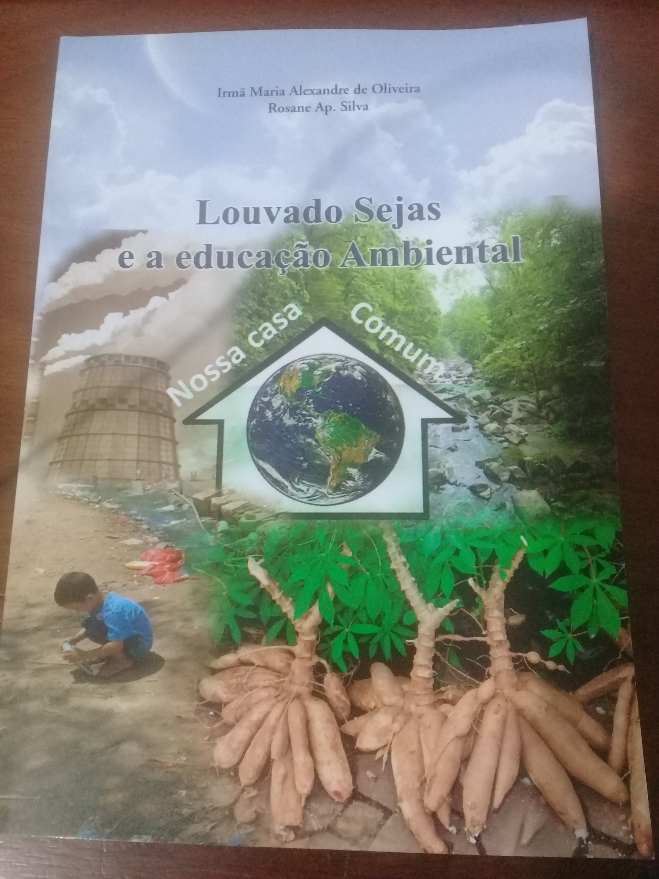
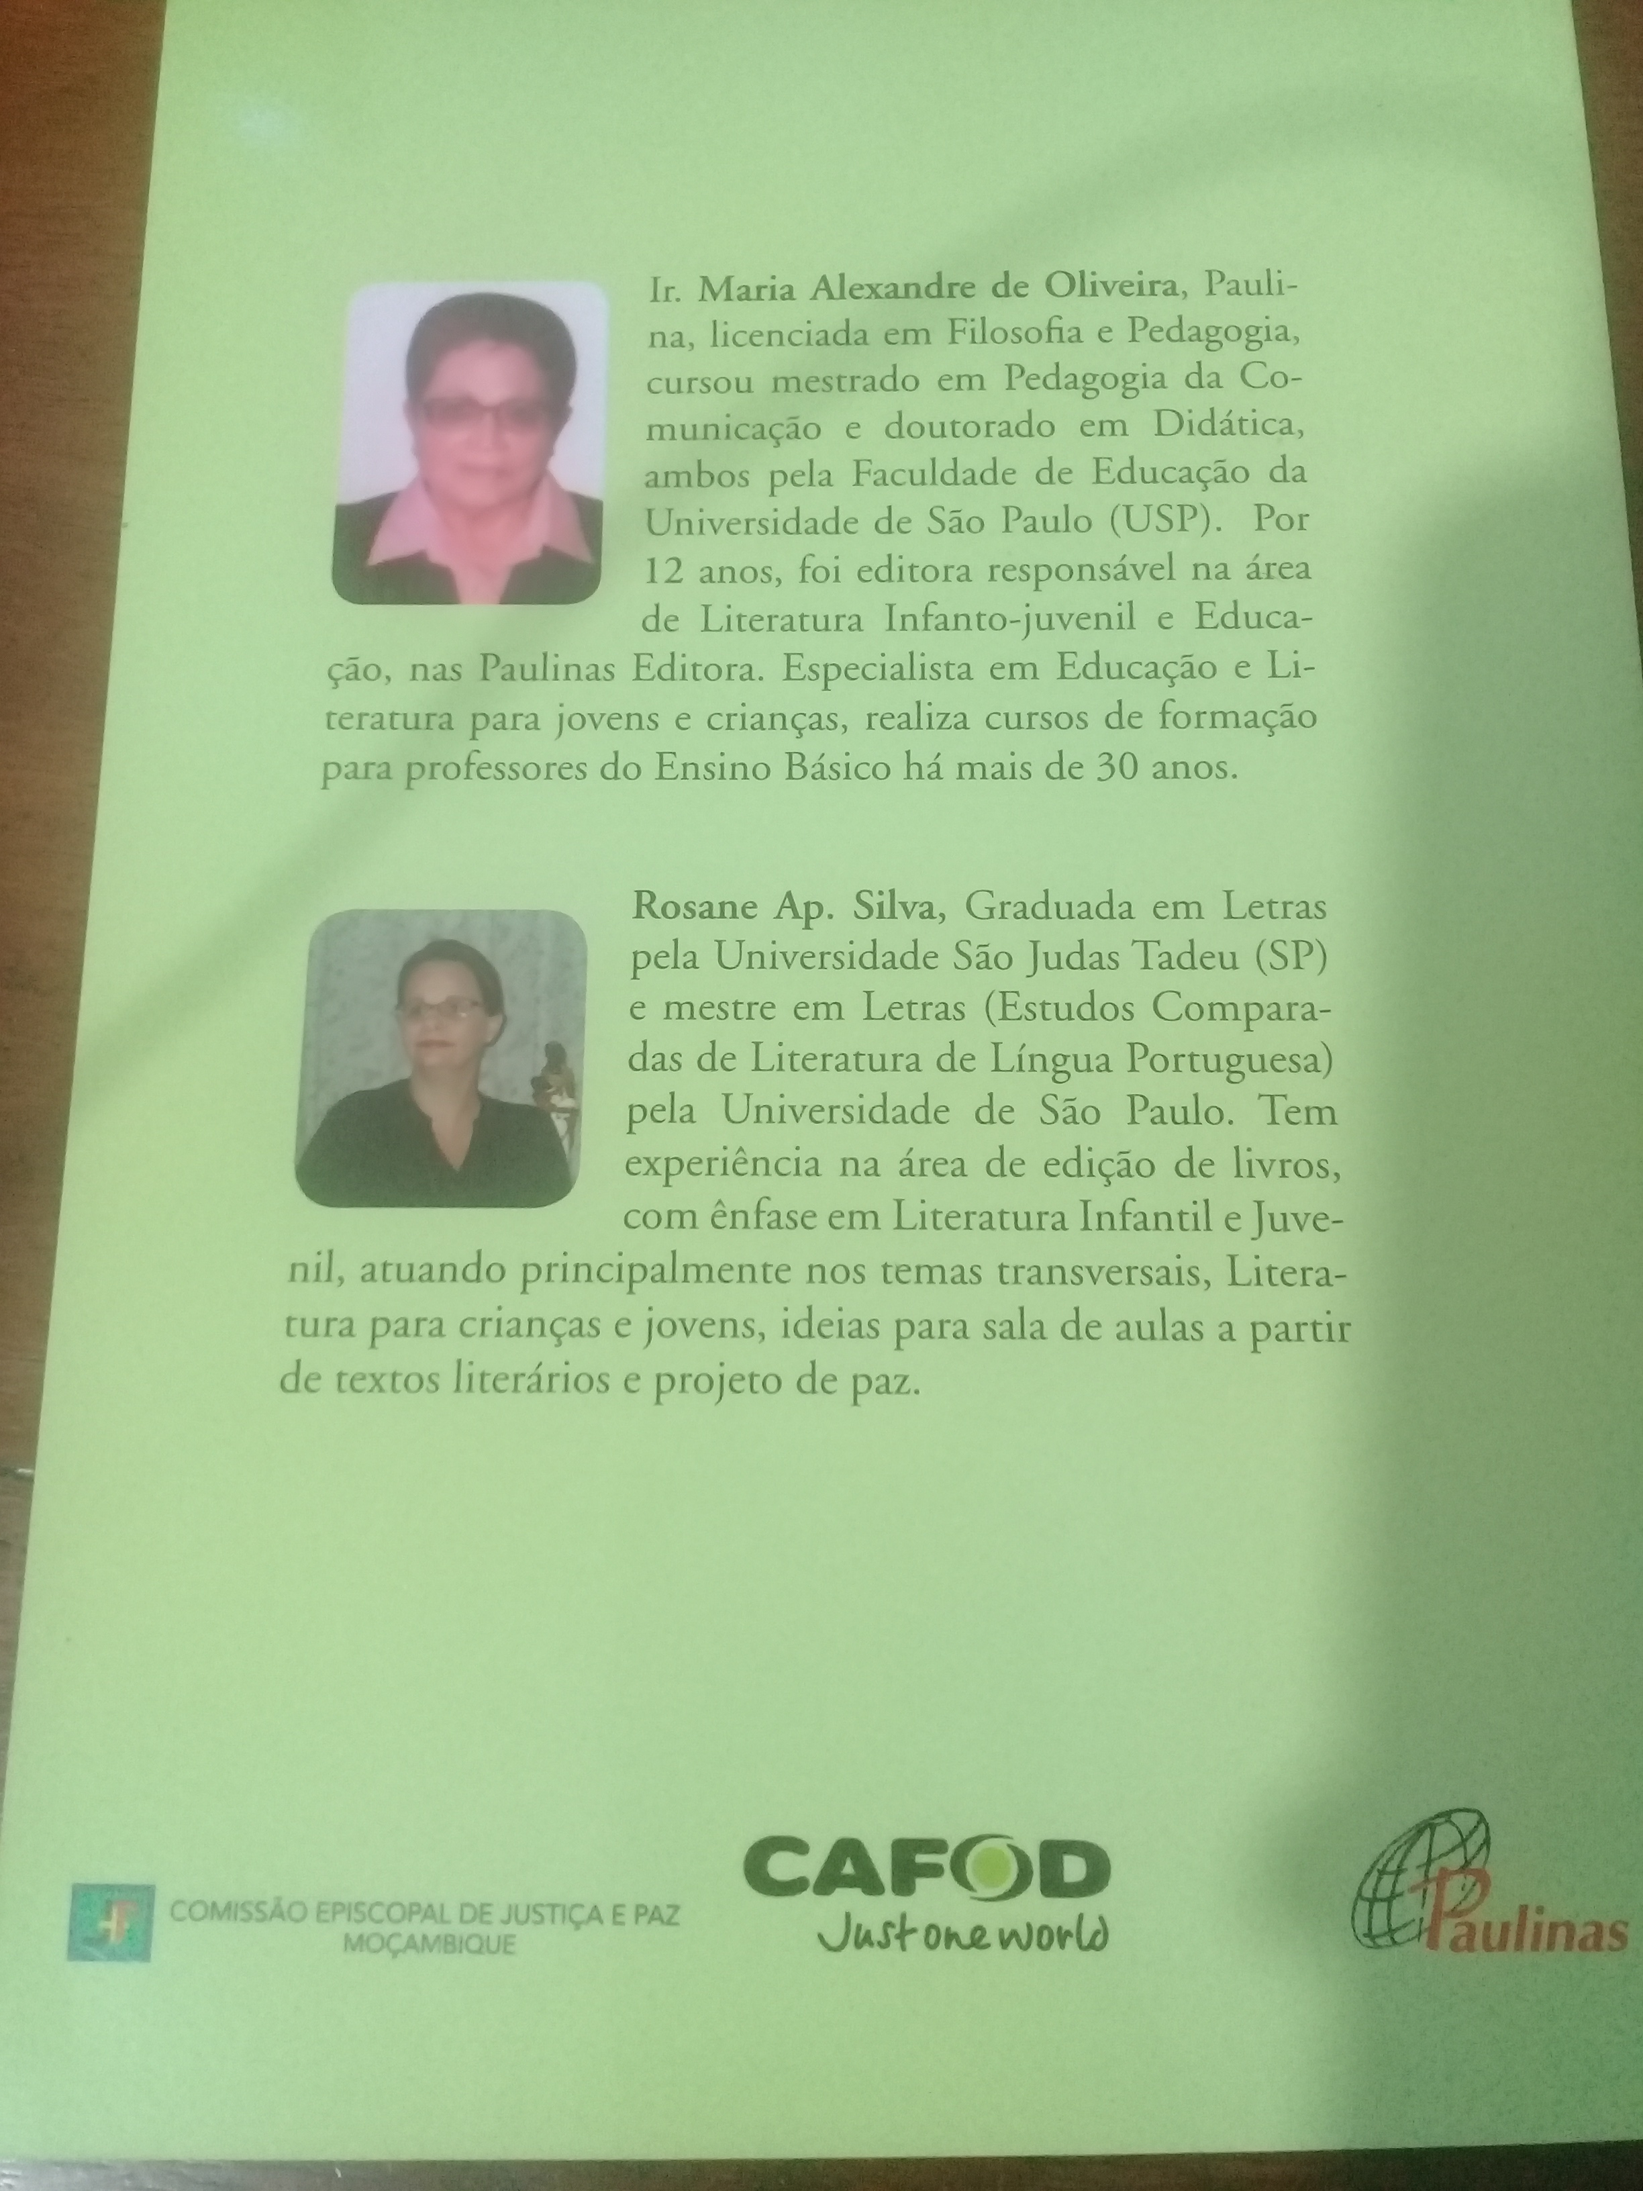

Slide 13
ECOLOGY OF DAILY LIFE
According to Laudato Si' nº 147, authentic development includes efforts to bring about an integral improvement in the quality of human life, and this entails considering the setting in which people live their lives. These settings influence the way we think, feel and act. In our rooms, our homes, our workplaces and neighborhoods, we use our environment as a way of expressing our identity.

Slide 14
We make every effort to adapt to our environment, but when it is disorderly, chaotic or saturated with noise and ugliness, such overstimulation makes it difficult to find ourselves integrated and happy.
We teach our children to maintain the Center clean and in order, collecting rubbish, planting and watering trees, etc.

Slide 15
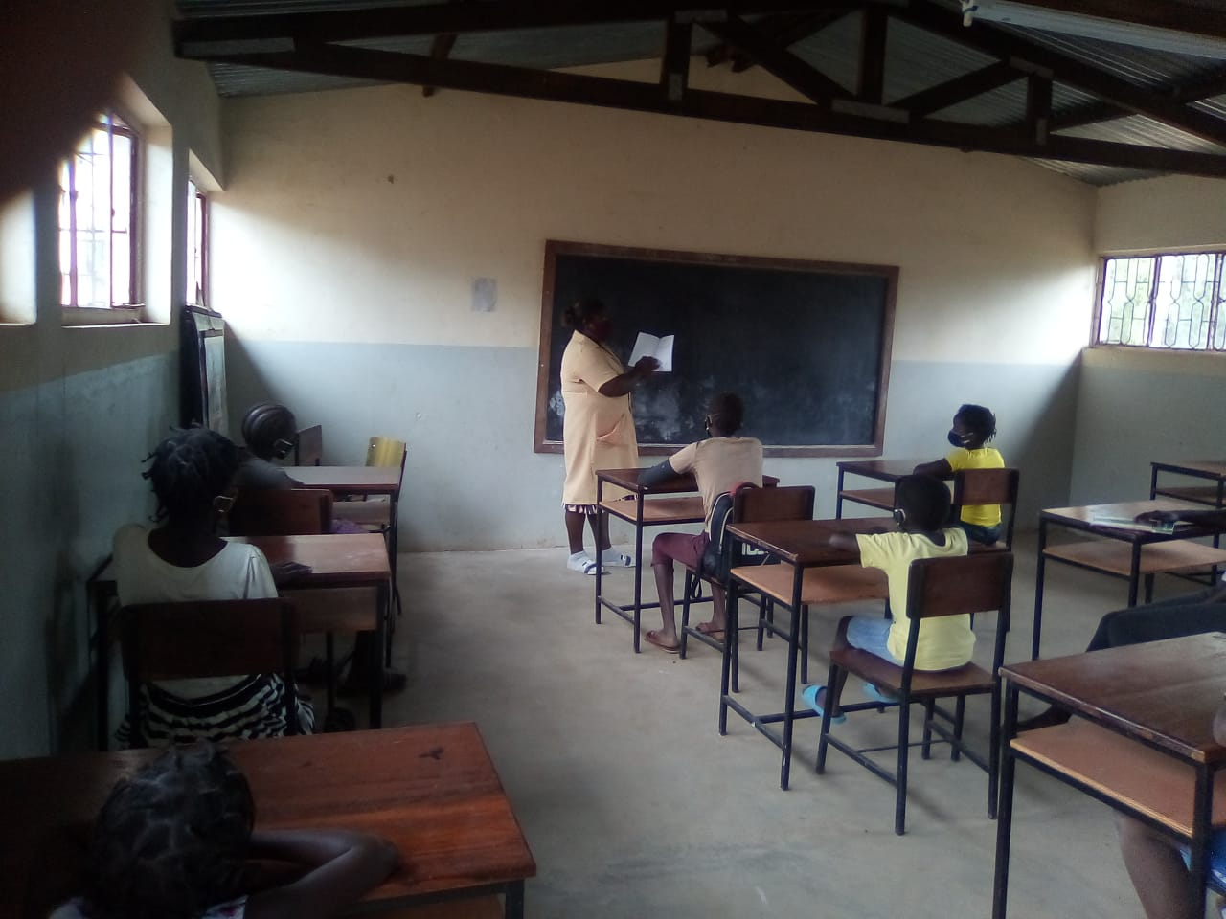
Massaca children with the educators
The educator is using a book entitled on Louvado Sejas e educação ambiental written by a pauline sister (based on the Laudato Si').

Slide 16
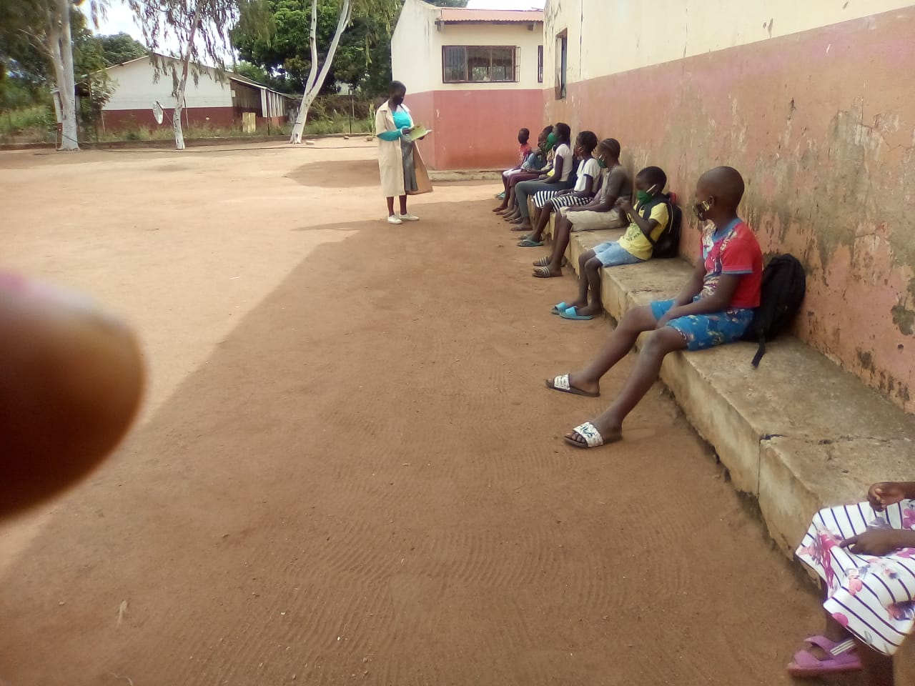

Slide 17
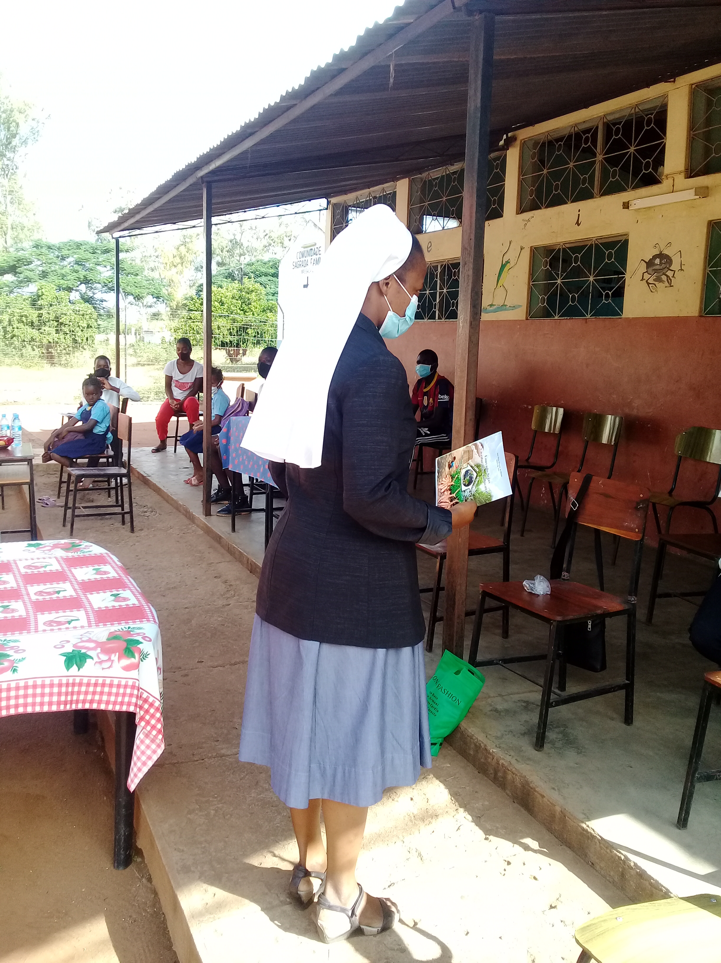
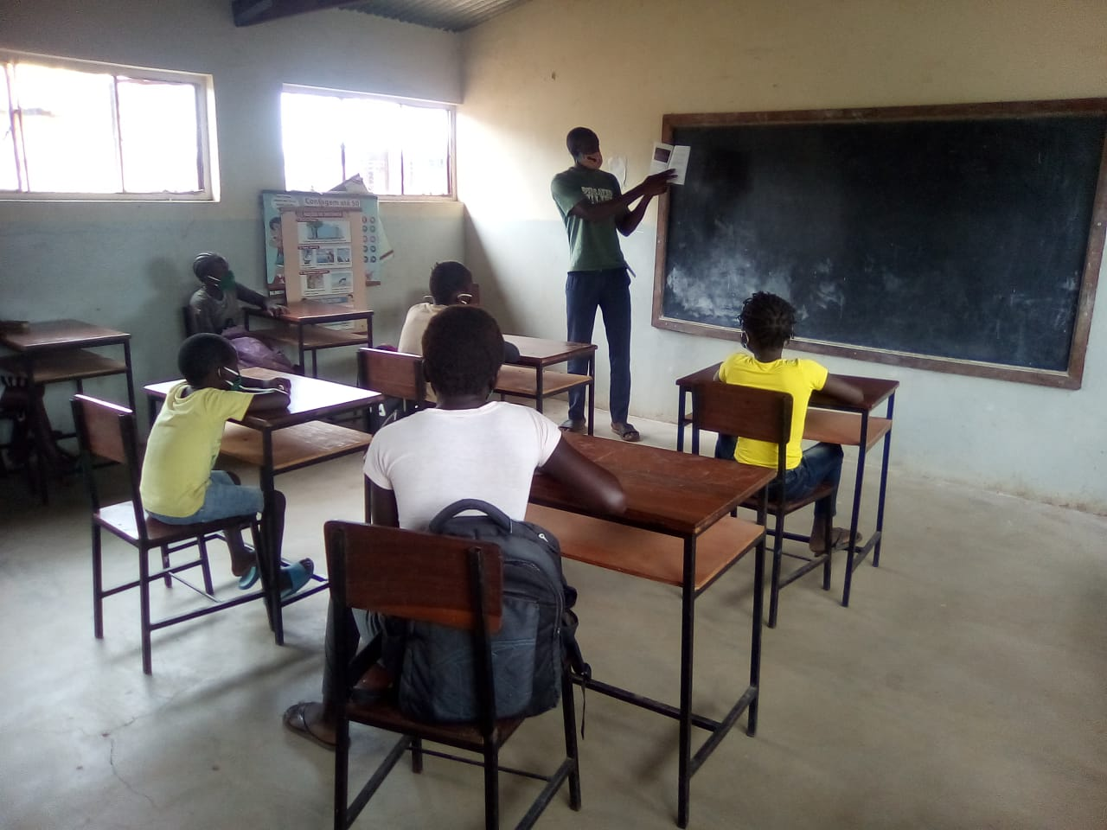
LECTURES IN SMALL GROUPS

Slide 18
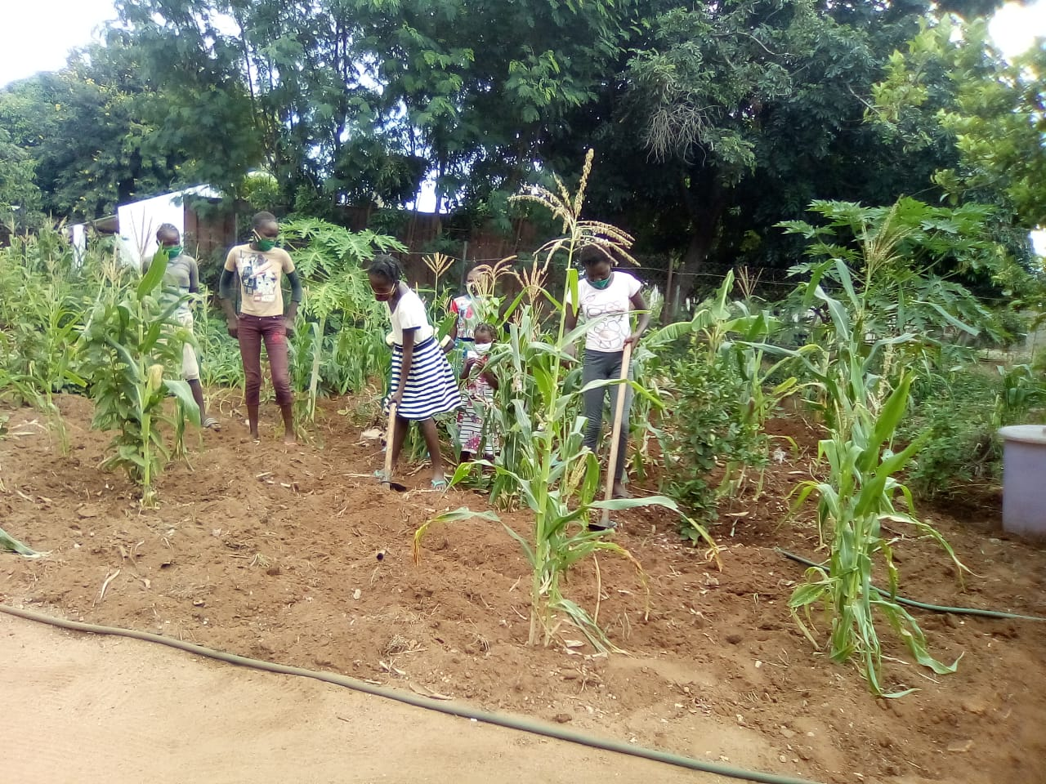
Children weeding

Slide 19
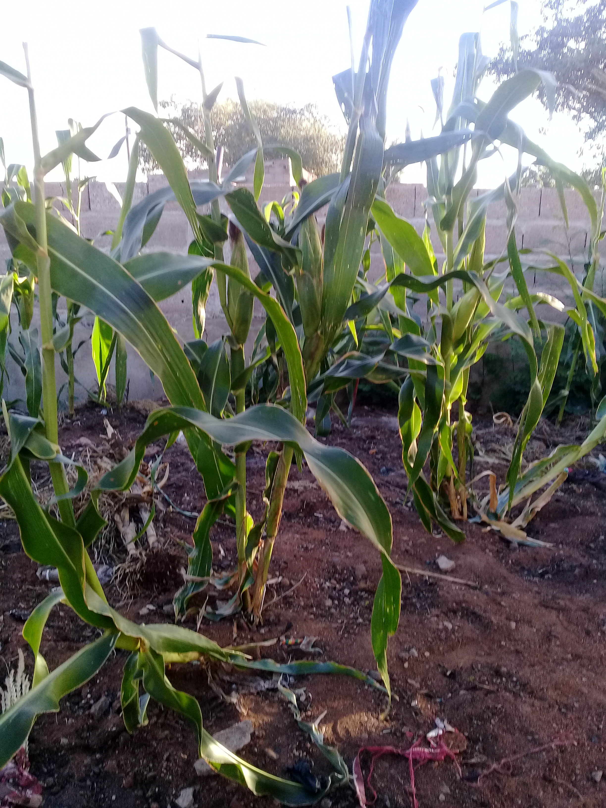

Slide 20
ACTIVITIES BEING CARRIED OUT
In this Marian month, children with early winter were filled with initiatives to make the best use of the land.
One of the concrete things is to open flowerbeds for small vegetable gardens, which in turn will be used for their own benefits as well, and this activity guarantees Teaching and Learning in general matters.

Slide 21
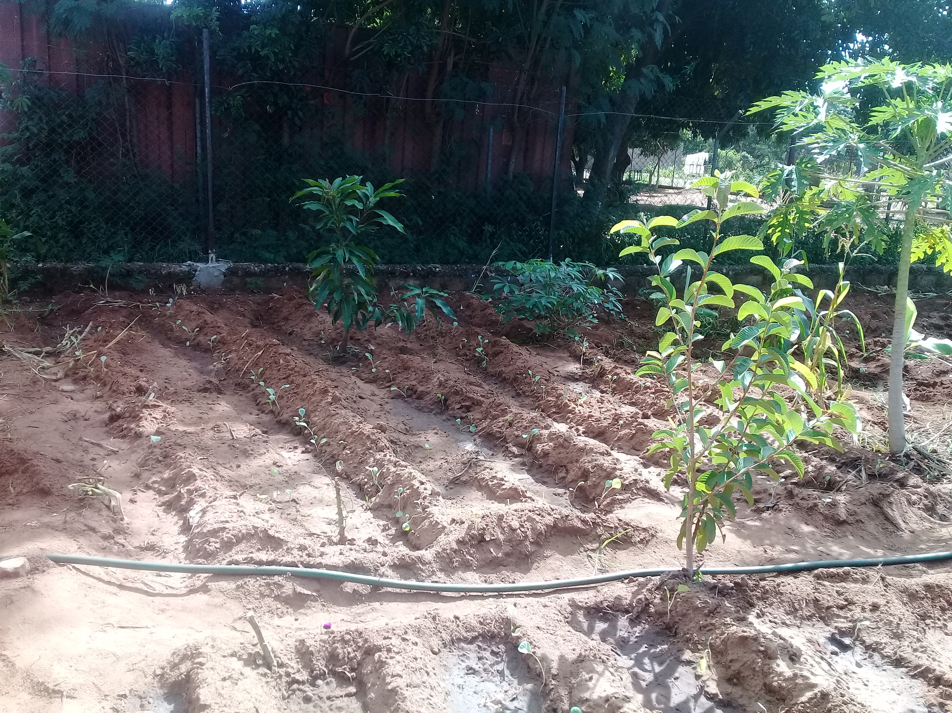
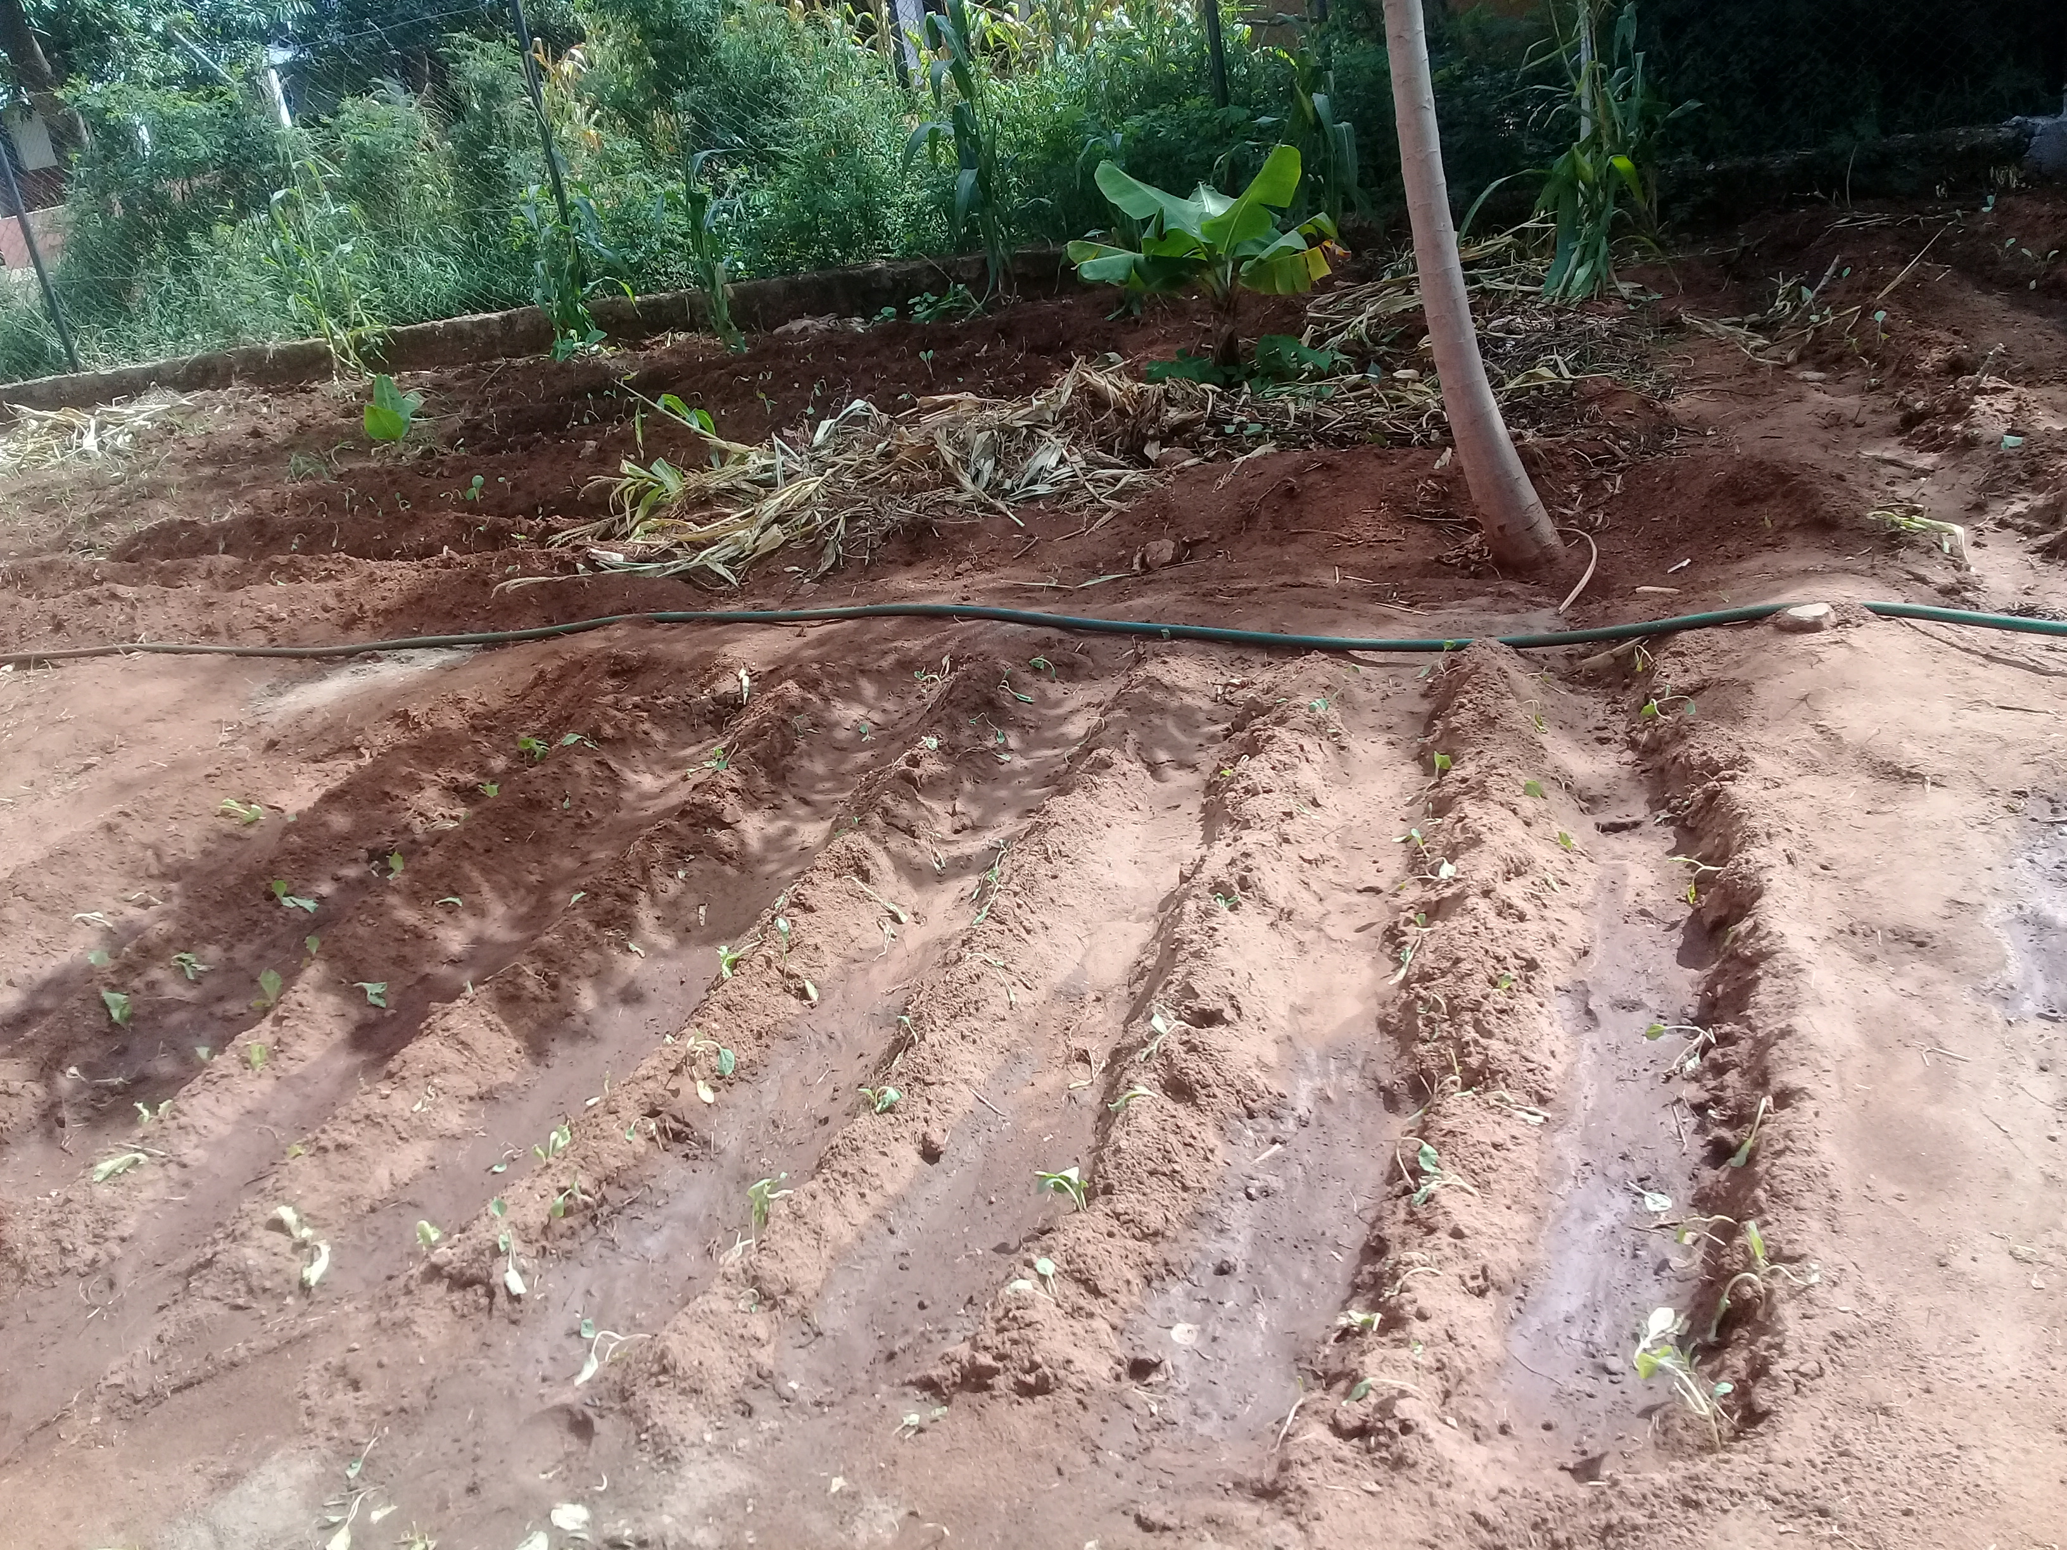

Slide 22
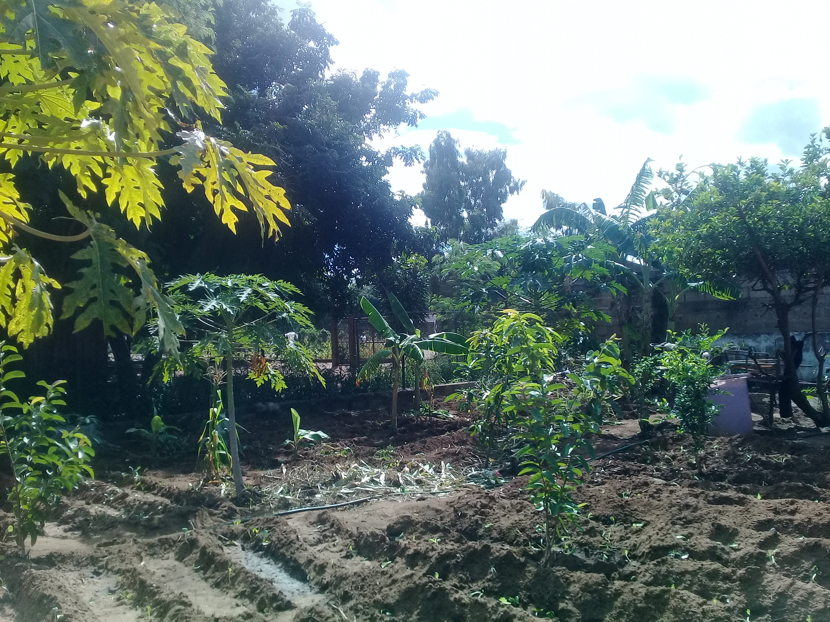

Slide 23
The other initiative was to introduce this education on the environment to the formisses and each community will make efforts to do something concrete for this same cause.
The children are engaged on the process of doing all kind of work that cares for a our common home.

Slide 24
PERSPECTIVES FOR A NEAR FUTURE
From the activities shared, we hope that in the future, we may expand such kind of activities to all the Centers, associates, Christian communities, villages, etc.

Slide 25
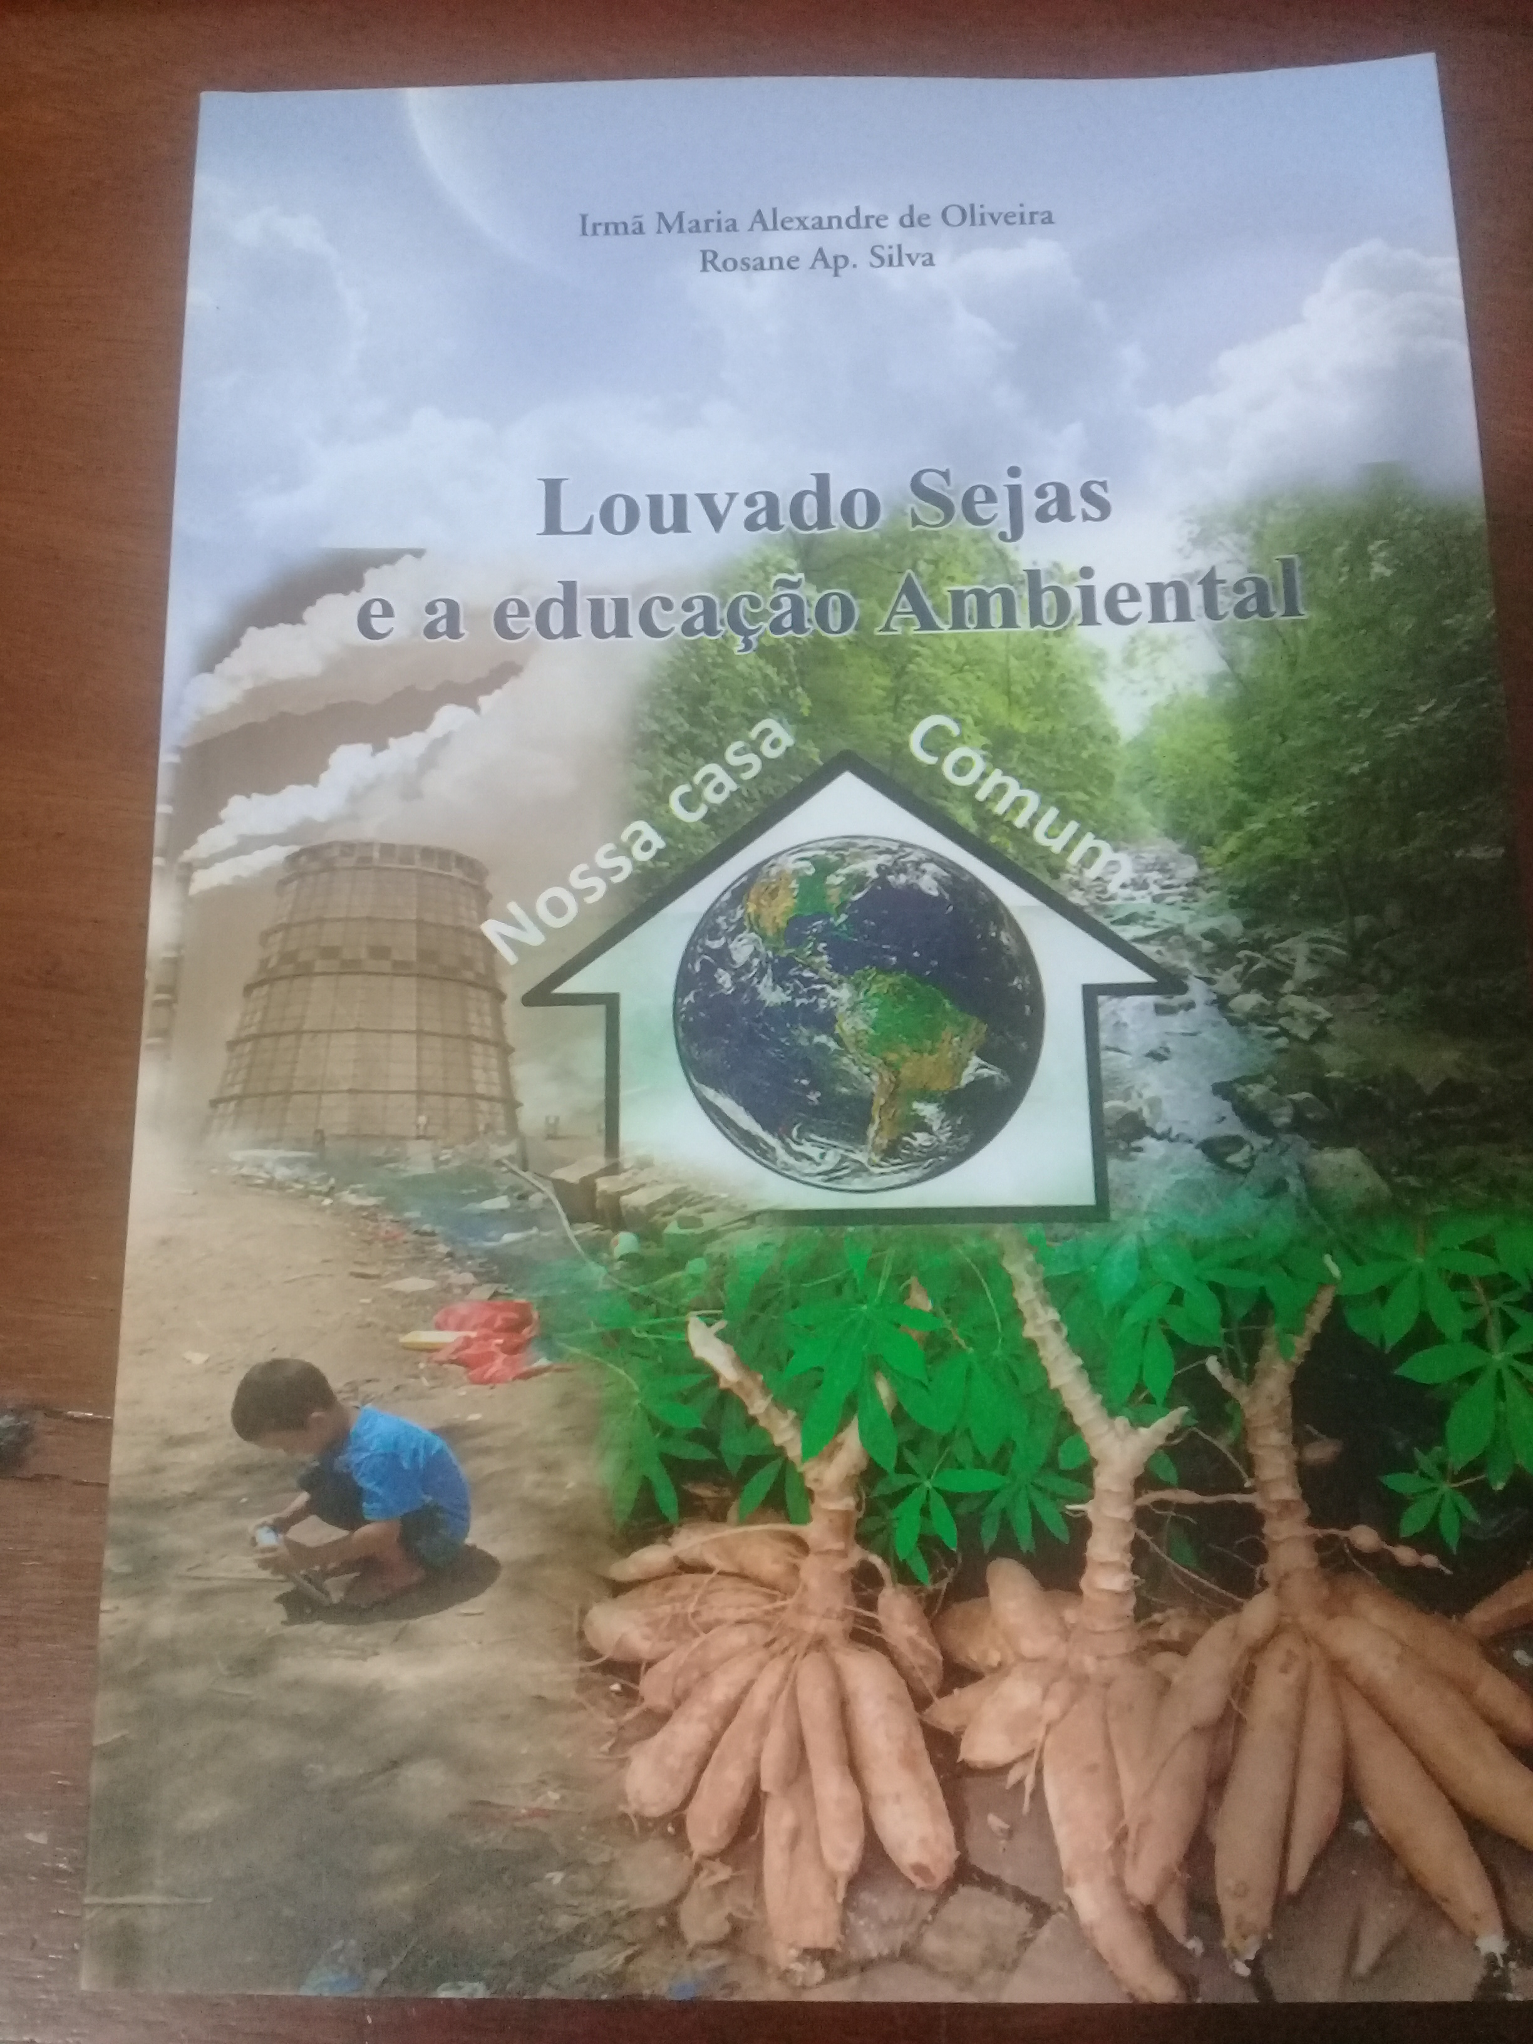
CONCLUSION
The care for nature is a task that we received since the history of creation, this is the reason why Genesis talks of responsibility.

Slide 26
BIBLIOGRAPHIC REFERENCES
Encyclical Letter Laudato Si' “Praise Be” Pope Francis, 2015. Vatican
he Holy Bible: New International Version.

Slide 27
OBRIGADA!
KHANIMAMBO!
TATENDA!
ZIKOMO!
THANKS!
ASANTE!
MERCI!

Slide 28
